Slide 1
COMMODITIES MANAGEMENT

Slide 2
ESSENTIAL MEDICINES PROCESS FLOW - current
HEALTH FACILITY
DISTRICT PHARMACIST
KEMSA
* Physical stock count on bin cards
Physically collect order form from facility
Manually rationalize order
Physically send facility order sheets to KEMSA
Generate manual divisional reports
Issue to service points
Receive physical order forms
Feed order into ERP
Supply commodities
* Physical quantification of commodities to order
Place physical order to KEMSA *
Receive supply
Carry out a stock count
Physically update new stock count on bin cards
Notes:
Contact Person at health facility – ideal situation: Store Manager; Real situation: Facility Head / Dpt. Head / Nurse
Physical Stock Count – transcription errors
Quantification – under-quantification or over-quantification thus not being served with the required stock based on consumption. Time taken in quantifying for all the commodities that need to be ordered
Place Order – Time taken in waiting for the DP to collect order and rationalize before physically sending to KEMSA. Could take up to a week.
Carry out stock count on receipt of supply – Time taken to do stock count and when updating stock count there could be cases of transcription errors.
No way to monitor nearing expiring products as well as no means of immediate escalation of expired products

Slide 3
Health Commodities Management Platform (HCMP)
HEALTH FACILITY
DISTRICT PHARMACIST
KEMSA
Reconcile stock count online
Receive email notification of ;
Orders placed
Expired commodities
Orders lead time
Approve order online, PDF is generated & emailed to KEMSA
Access online reports to monitor consumption trends.
Compare cost of expiries against cost of orders placed
Issue to service points
Decommission expired commodities
Receive order
Feed order into ERP
Supply commodities
Auto-quantification of commodities & placement of order online
Update supply delivery online
Generate facility reports
Notes:
System capabilities – Online, real-time and 24-hr accessibility
Health Facility user – Ideal situation: Store Manager; Real Situation: as prev. slide
Reconcile stock count – based on consumption and receipt, the system would extrapolate the current stock count and user would just need to take a few minutes to counter-check the values
Decommission expired commodities – email & sms notification to DP. Immediate escalation & action
Auto-quantification – formulation of exact quantities when ordering based on consumption and a buffer stock. No time required to carry this out. Order what you need philosophy. Minimizes over supply / under supplies
Email order – Immediate action
Update supply online – mitigate transcription errors

Slide 4
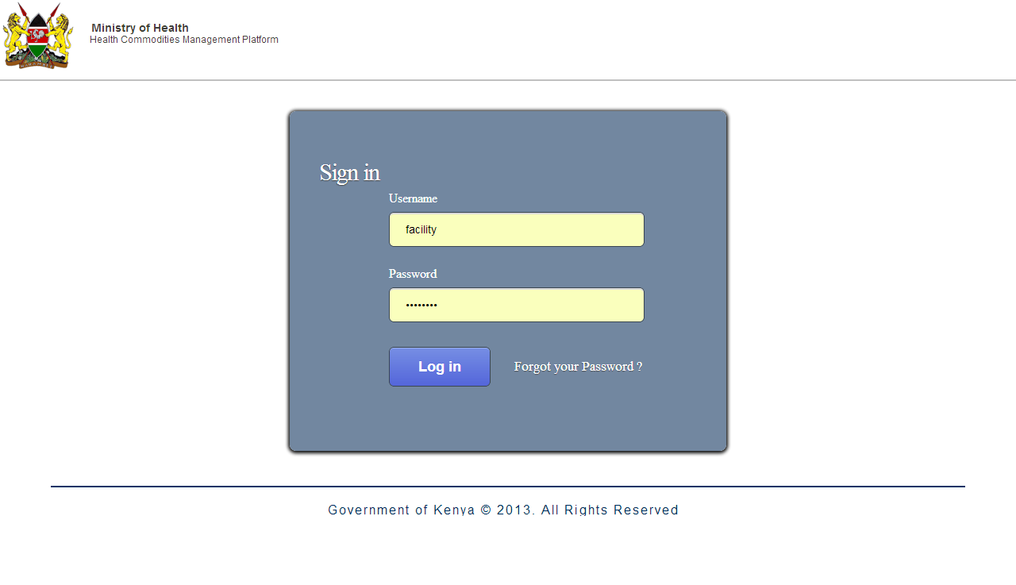
LEVEL 1: HEALTH FACILITY

Slide 5
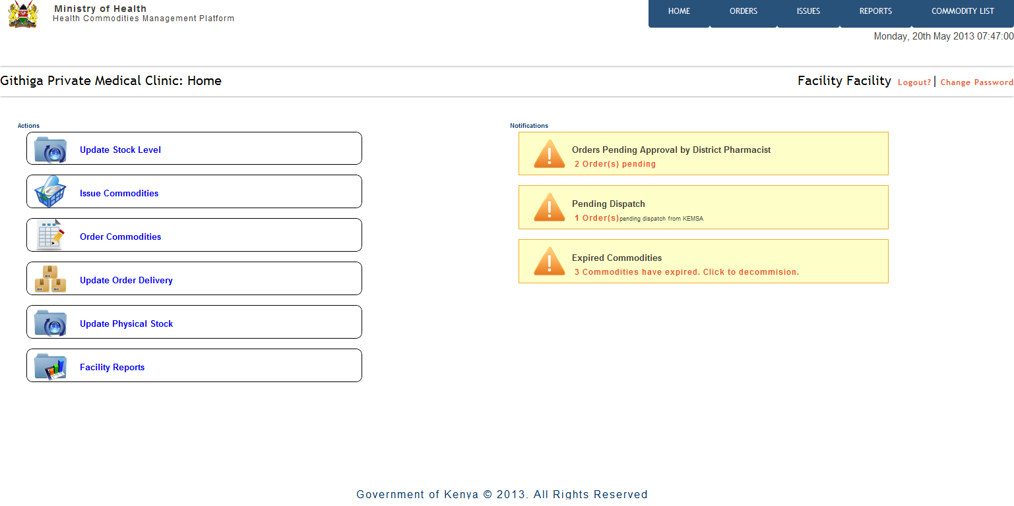
Home Screen
Notes:
More functionality is enabled to allow efficient use of the system in issuing commodities to the respective service points within the facility, ordering commodities to KEMSA, updating order deliveries from KEMSA onto the system and generation of reports from the system on consumption trends, expiries and orders placed in a certain duration.
Additional information is notifications on orders placed and their positioning in the processing cycle, whether approved by the DP or pending dispatch from KEMSA, expired commodities awaiting decommissioning for their proper disposal and call out for immediate escalation on replenishments wherever stocked out.

Slide 6
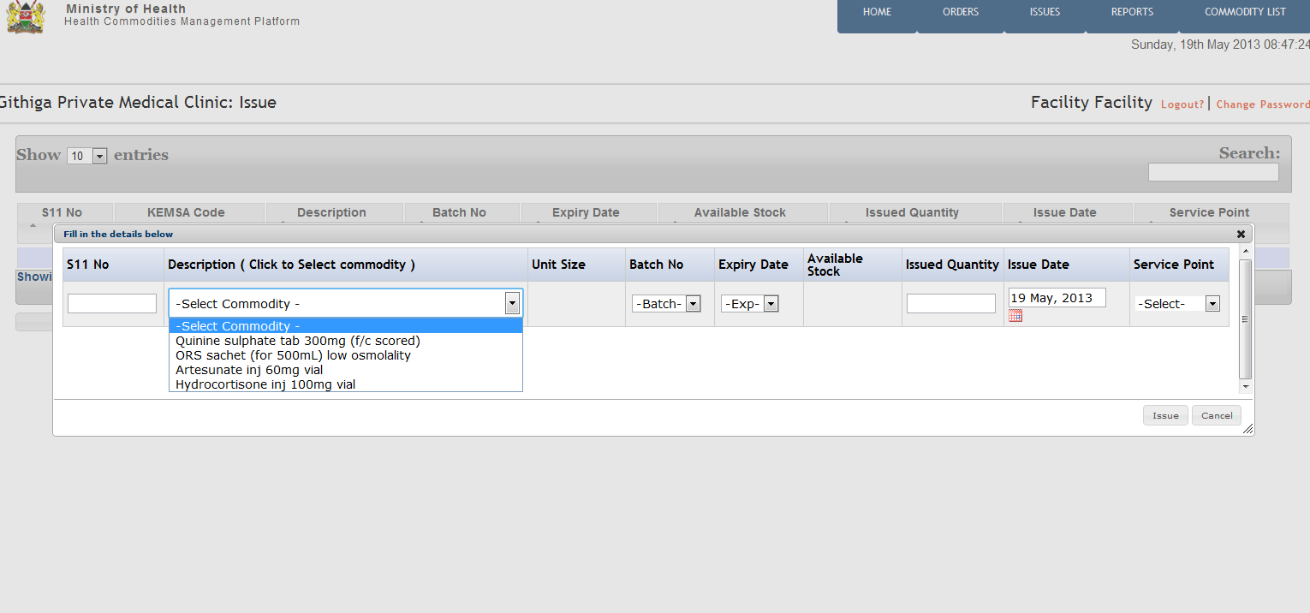
Issue Commodities to Service Points
Notes:
Issuing to commodities to service points within the facility.

Slide 7
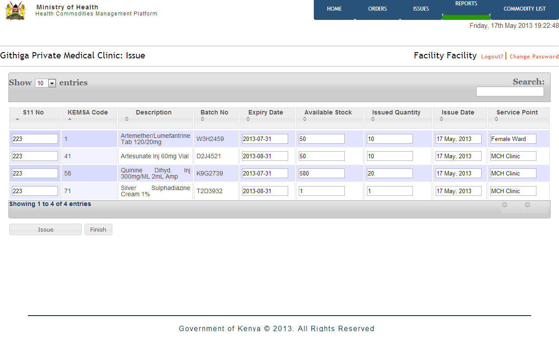
Issue Commodities to Service Points

Slide 8
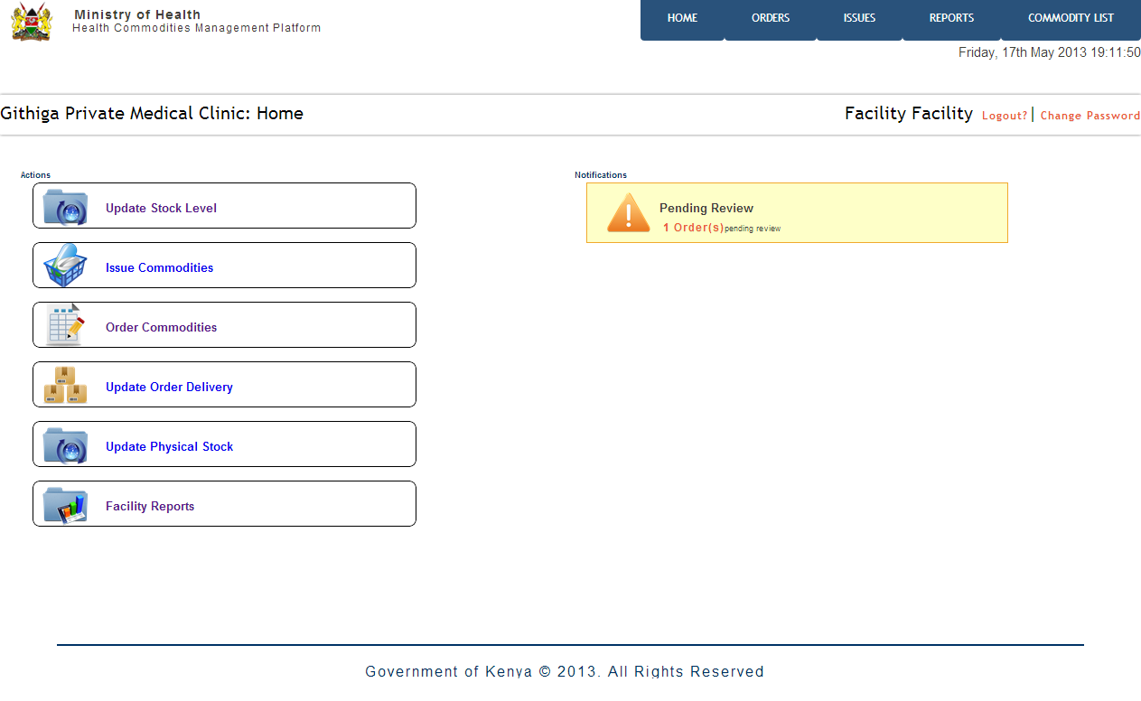
Home Screen

Slide 9
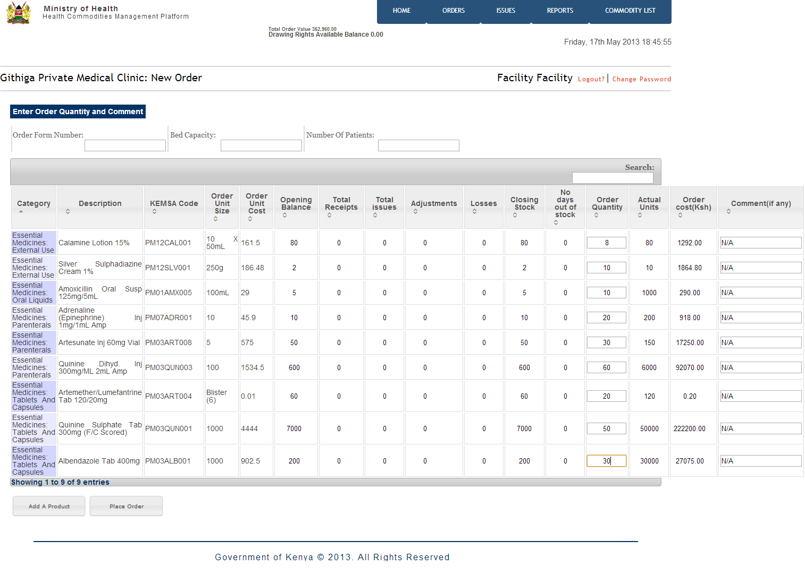
Place Order – Quantification of commodities
Notes:
Orders can be placed via the system to KEMSA.
The system quantifies the stock needed for ordering based on the last consumption from the last order to date taking into consideration a one month buffer stock.

Slide 10
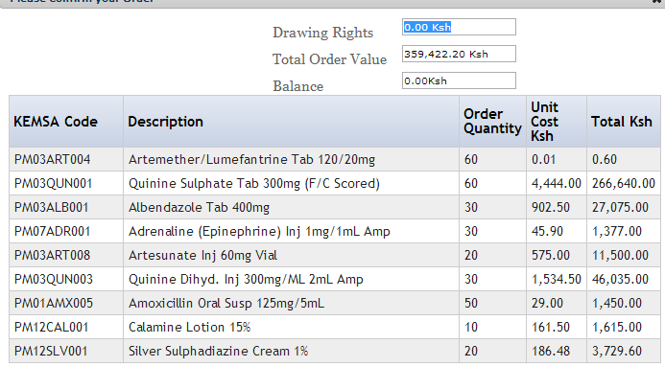
Place Order – Confirmation of Order

Slide 11
Home Screen

Slide 12
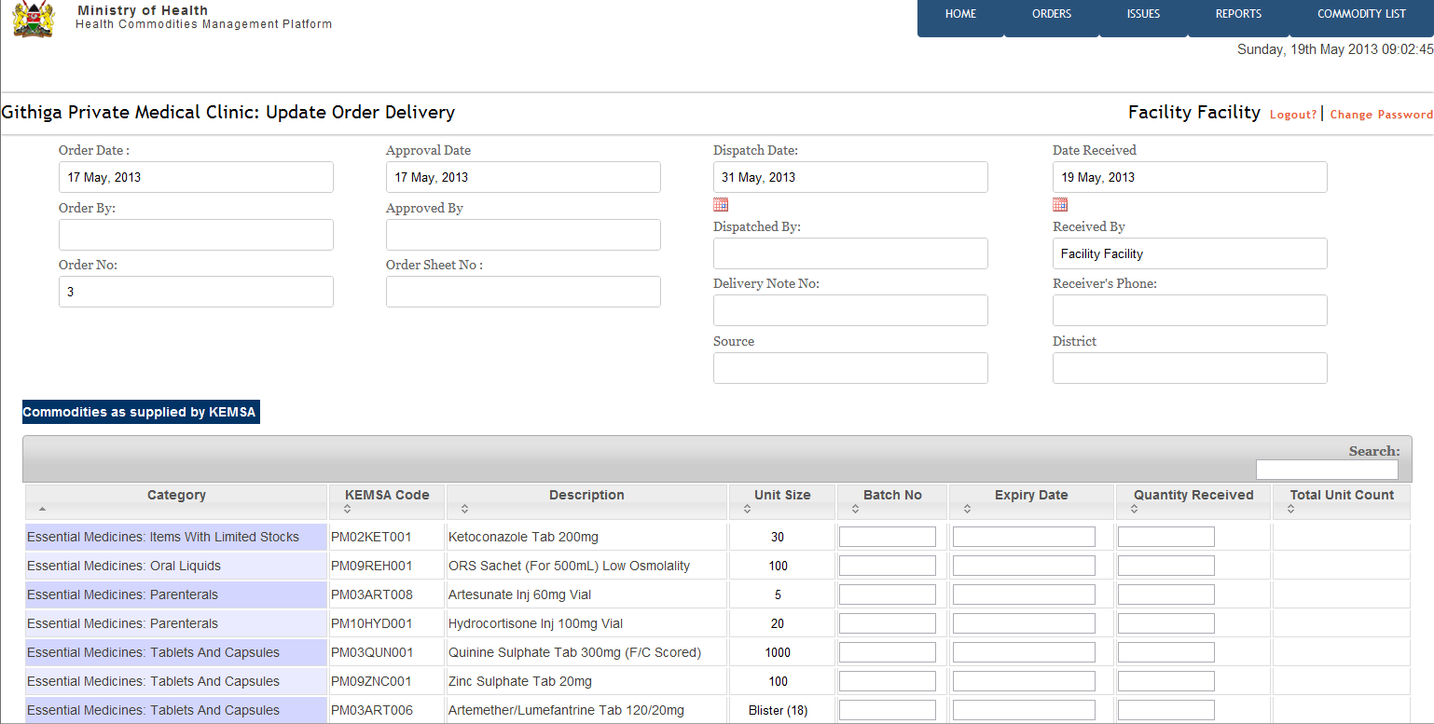
Update Order Delivery
Notes:
Once the order has been honored and serviced by KEMSA the facility reflects the order particulars onto the system.

Slide 13
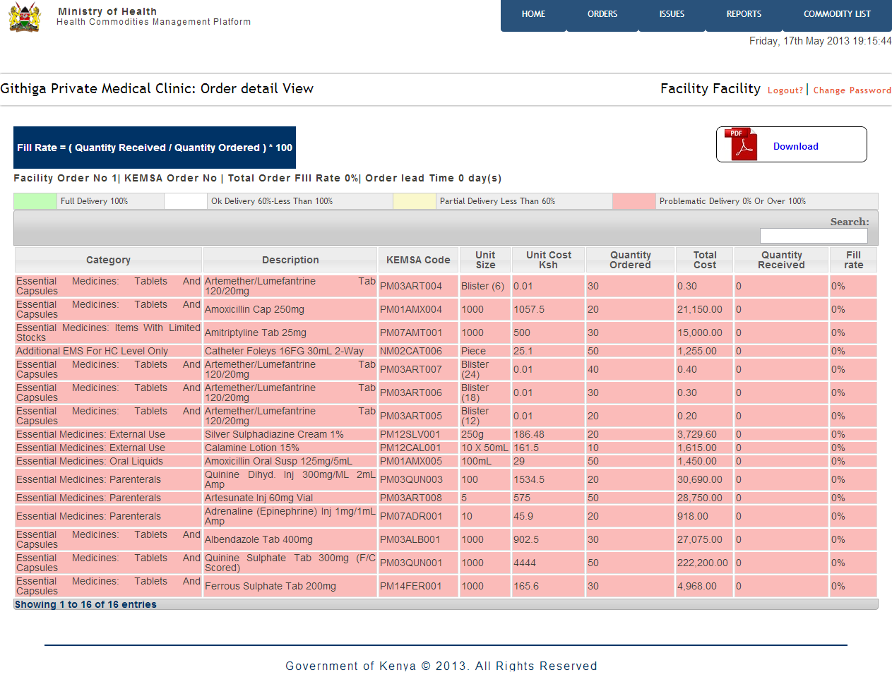
Update Order Delivery – Monitor Order Fill Rate
Notes:
The tool calculates the respective order fill rate and notifies the user accordingly on whether they have been serviced efficiently for the order they placed.

Slide 14
Home Screen

Slide 15
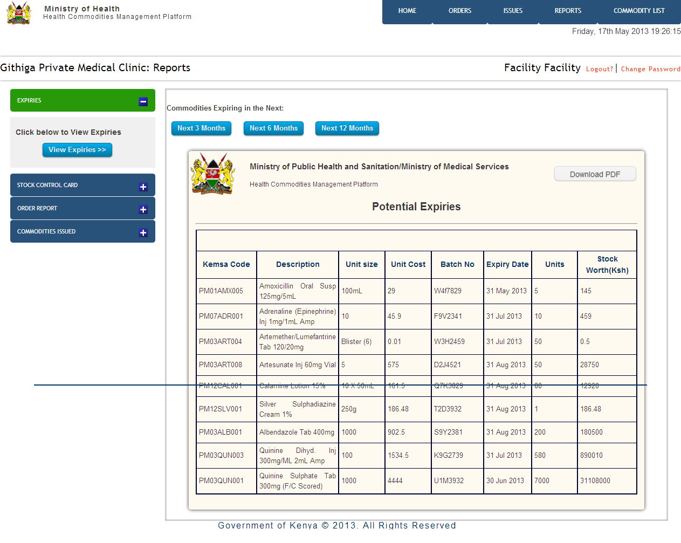
Facility Reports – Potential Expiries
Notes:
Report on potential expiries

Slide 16
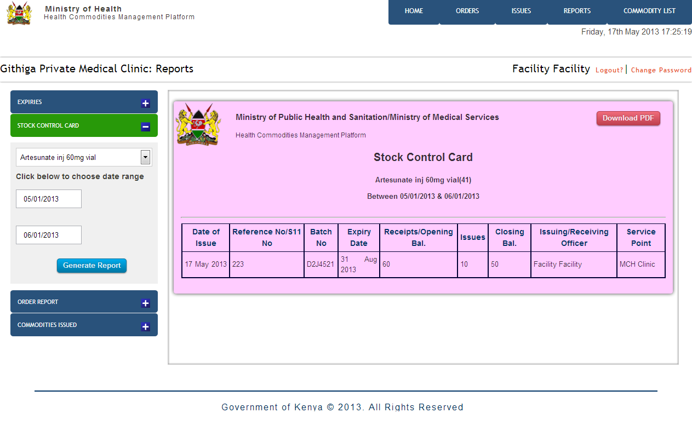
Facility Reports – Stock Control Card (Bin Card)
Notes:
Report on consumption for a particular commodity through a given period

Slide 17
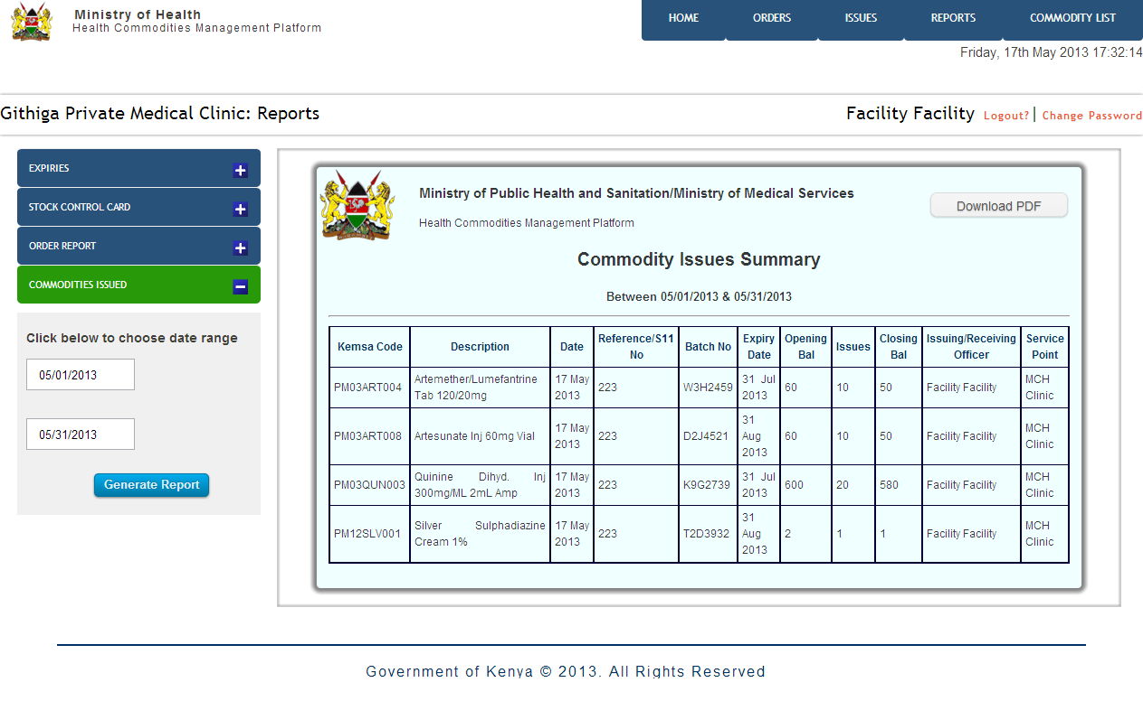
Facility Reports – Periodic Commodity Issues
Notes:
Report on commodities issued in a reporting period

Slide 18
LEVEL 2: DISTRICT PHARMACIST

Slide 19
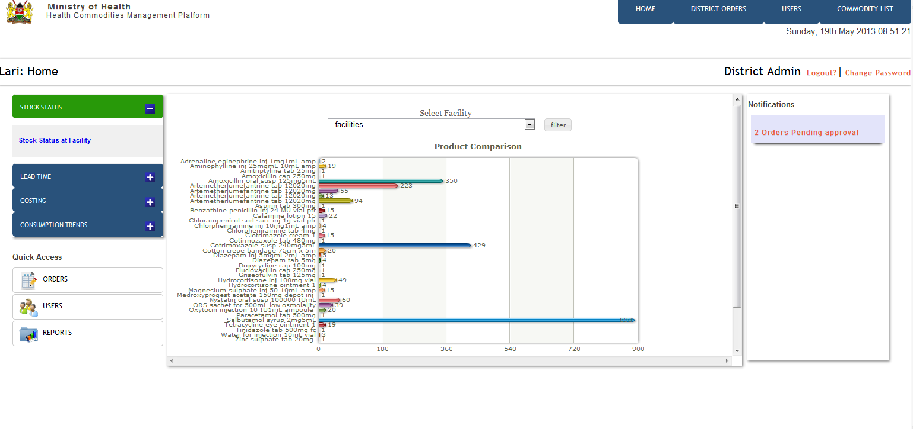
Dashboard – Commodities Stock Status
Notes:
Dashboard overview on the facilities performance and status on consumption levels as at the current period.

Slide 20
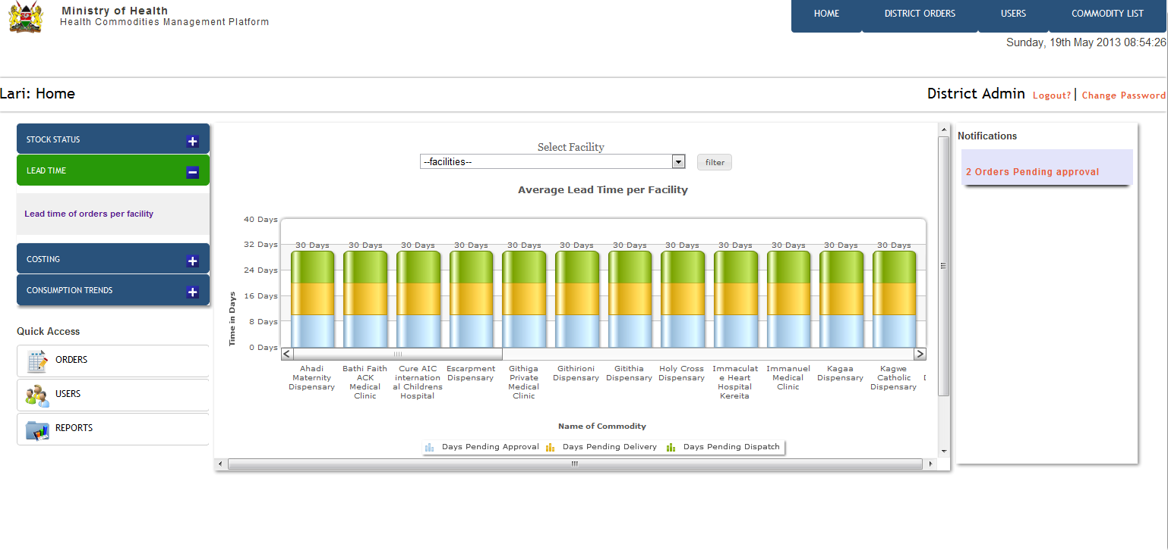
Dashboard – Orders Lead Time
Notes:
Lead time monitoring the duration between when the order was placed at the facility to the point the DP approves to the point KEMSA services the order back to the facility

Slide 21
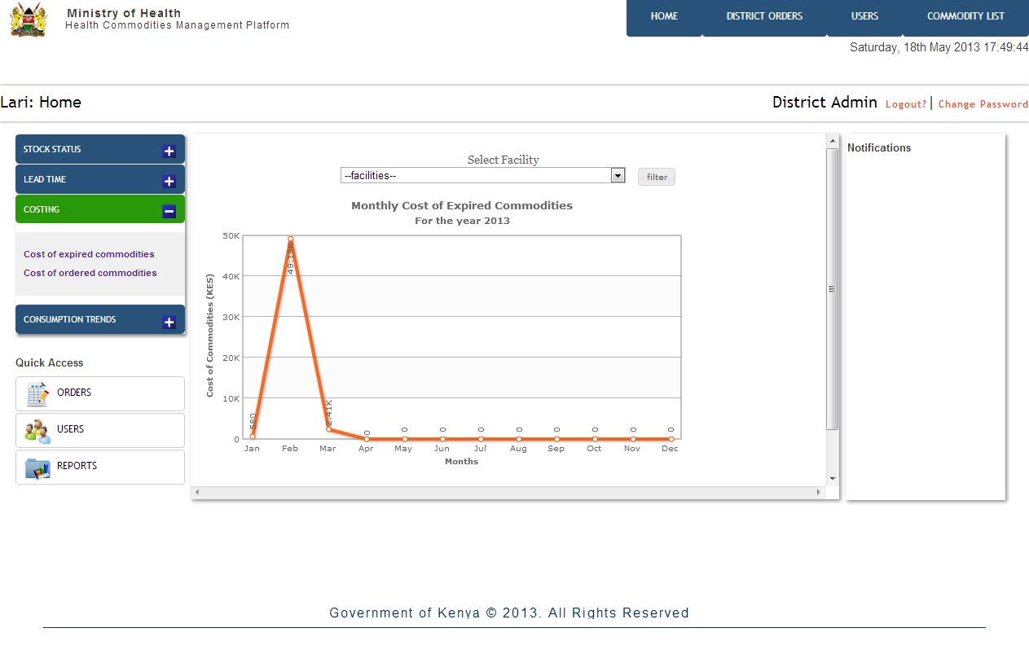
Dashboard – Cost of Expired Commodities
Notes:
Cost of expired commodities for all the facilities in the district through out the year

Slide 22
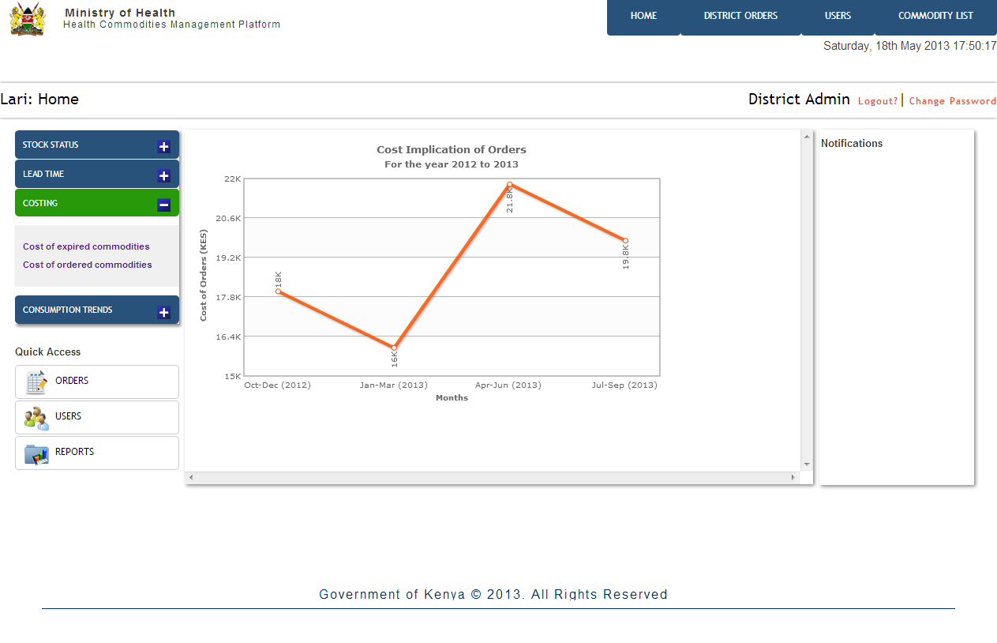
Dashboard – Cost of Orders Placed
Notes:
Trend on cost of orders placed by the facilities throughout the ordering cycles.

Slide 23
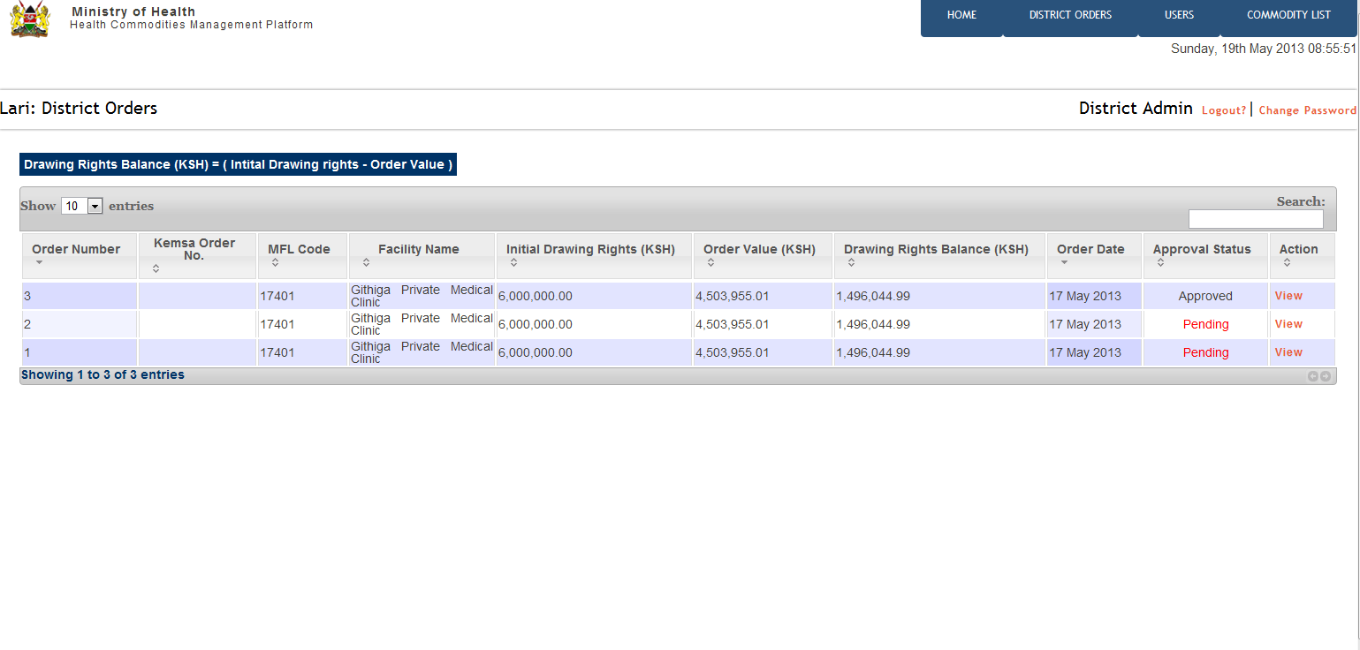
Orders Approval
Notes:
List of all orders placed by facilities pending approval by the DP

Slide 24
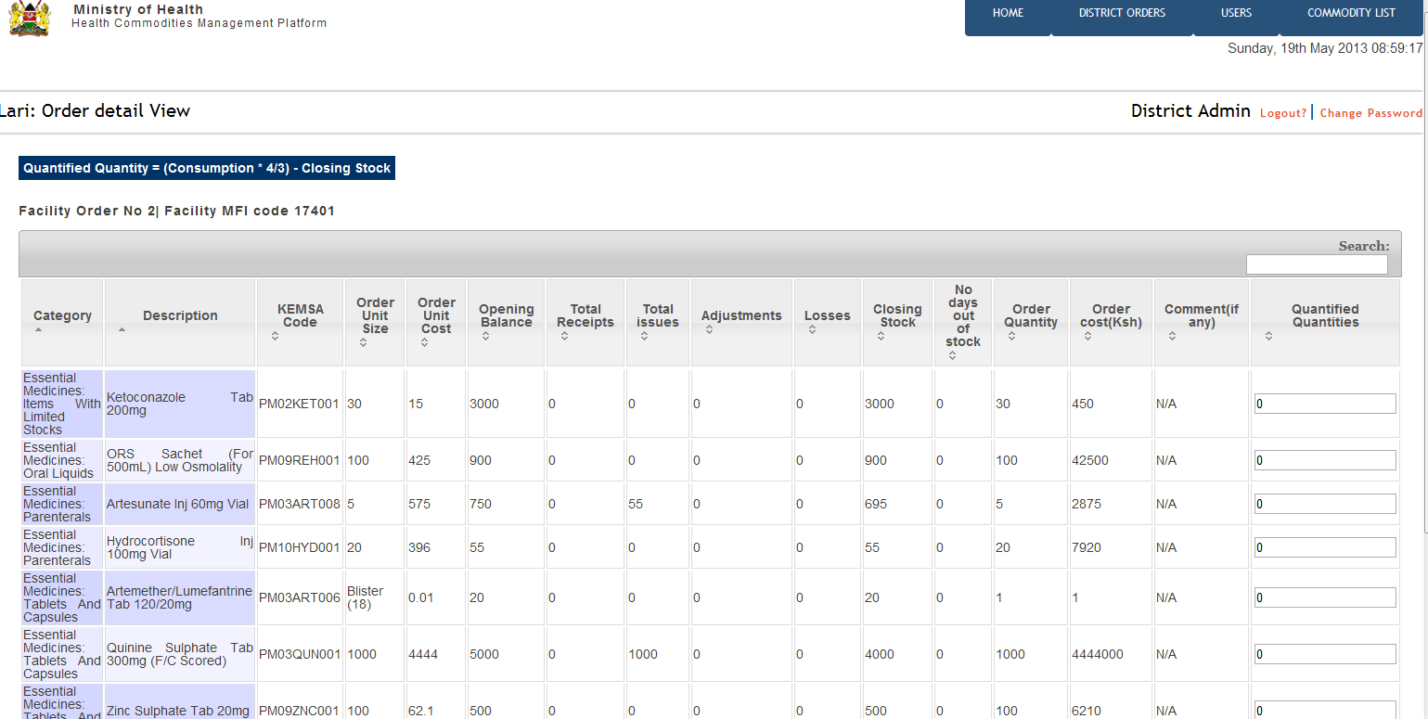
Orders Approval

Slide 25
Dashboard

Slide 26
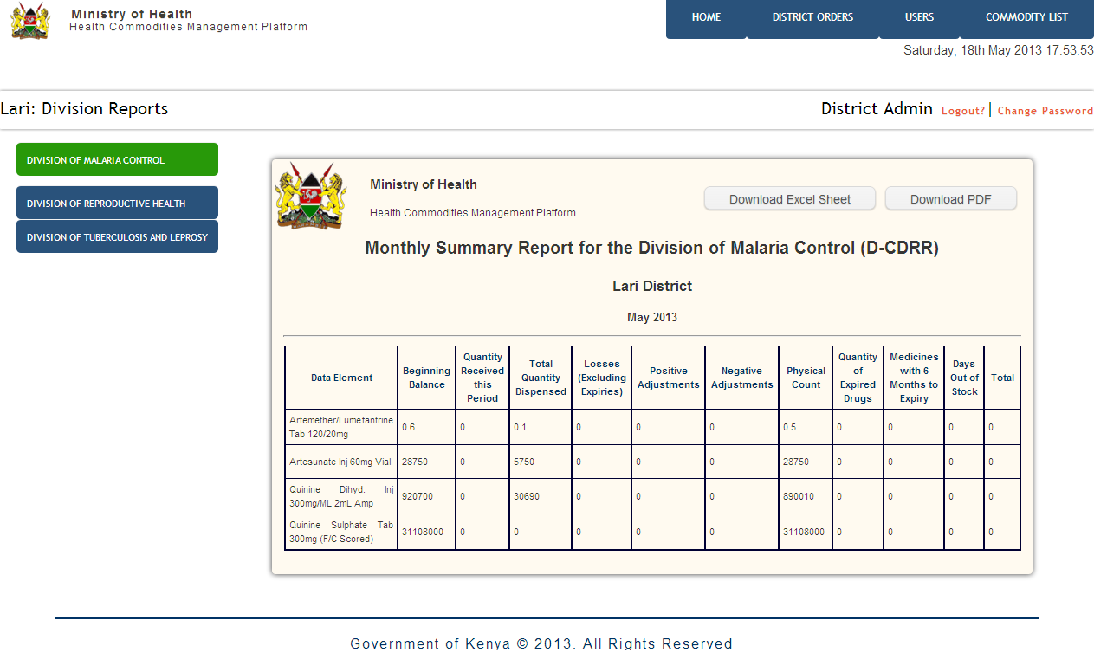
Division Reports – Division of Malaria Control
Notes:
Reports on divisional commodities consumption – Malaria, Reproductive Health, TB & Leprosy

Slide 27
